Slide 1
FINANCIAL DASHBOARD
Interactive Dashboards & Insights
Presented by : HARI KRISHNAN.S

Slide 2
Project Overview
Objective
Scope
Deliverable
Build a dynamic Power BI dashboard to monitor key business metrics and drive data-driven decision making across all departments.
Sales performance analysis, customer trend identification, and comprehensive monthly growth tracking with comparative insights.
Interactive Power BI report featuring drill-down capabilities, automated refresh functionality, and stakeholder-friendly visualizations.

Slide 3

Data Sources
Primary Data
Supporting Data
Transaction tables sourced from multiple formats including CSV files, Excel spreadsheets, and enterprise databases. This comprehensive data foundation ensures complete visibility into business operations and customer interactions.
Additional datasets that enrich our analysis capabilities, including product catalog information, regional mapping data, and structured calendar tables for time-based analysis.
Product catalog
Sales transactions
Regional mapping
Customer records
Calendar table
Order details
Refresh Schedule: Automated daily/weekly refresh ensures stakeholders always have access to the most current business intelligence.

Slide 4
Data Preparation
01
02
Data Cleaning & Transformation
Quality Assurance
Utilized Power Query's advanced capabilities to standardize data formats, normalize text fields, and ensure consistency across all data sources for reliable analysis.
Implemented comprehensive data quality checks to identify and resolve missing values, eliminate duplicate records, and validate data integrity throughout the pipeline.
03
04
Advanced Calculations
Data Architecture
Developed sophisticated calculated columns and DAX measures to generate business-critical metrics and enable complex analytical capabilities within the dashboard.
Constructed optimized date hierarchies and custom KPI frameworks to support flexible time-based analysis and performance monitoring requirements.

Slide 5





Key Metrics & KPIs
Revenue Tracking
Growth Analysis
Product Performance
Comprehensive sales monitoring including Year-to-Date and Month-to-Date totals with comparative analysis against historical performance benchmarks.
Revenue growth percentage calculations comparing current performance against previous periods to identify trends and acceleration patterns.
Top-selling products and category analysis with profitability metrics to optimize inventory management and marketing focus areas.
Regional Insights
Customer Metrics
Geographic sales performance tracking with regional comparisons to identify market opportunities and resource allocation needs.
Customer acquisition and retention rate monitoring to understand customer lifecycle value and loyalty program effectiveness.

Slide 6
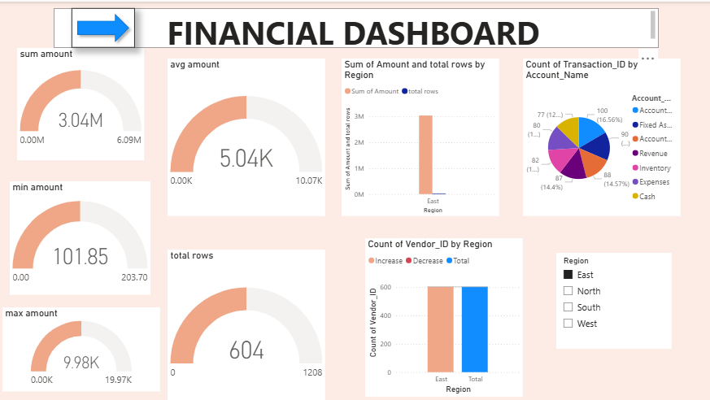
Key Metrics & KPIs
Revenue Tracking
Growth Analysis
Product Performance
Revenue growth percentage calculations comparing current performance against previous periods to identify trends and acceleration patterns.
Top-selling products and category analysis with profitability metrics to optimize inventory management and marketing focus areas.
Regional Insights
Customer Metrics
Geographic sales performance tracking with regional comparisons to identify market opportunities and resource allocation needs.
Customer acquisition and retention rate monitoring to understand customer lifecycle value and loyalty program effectiveness.

Slide 7
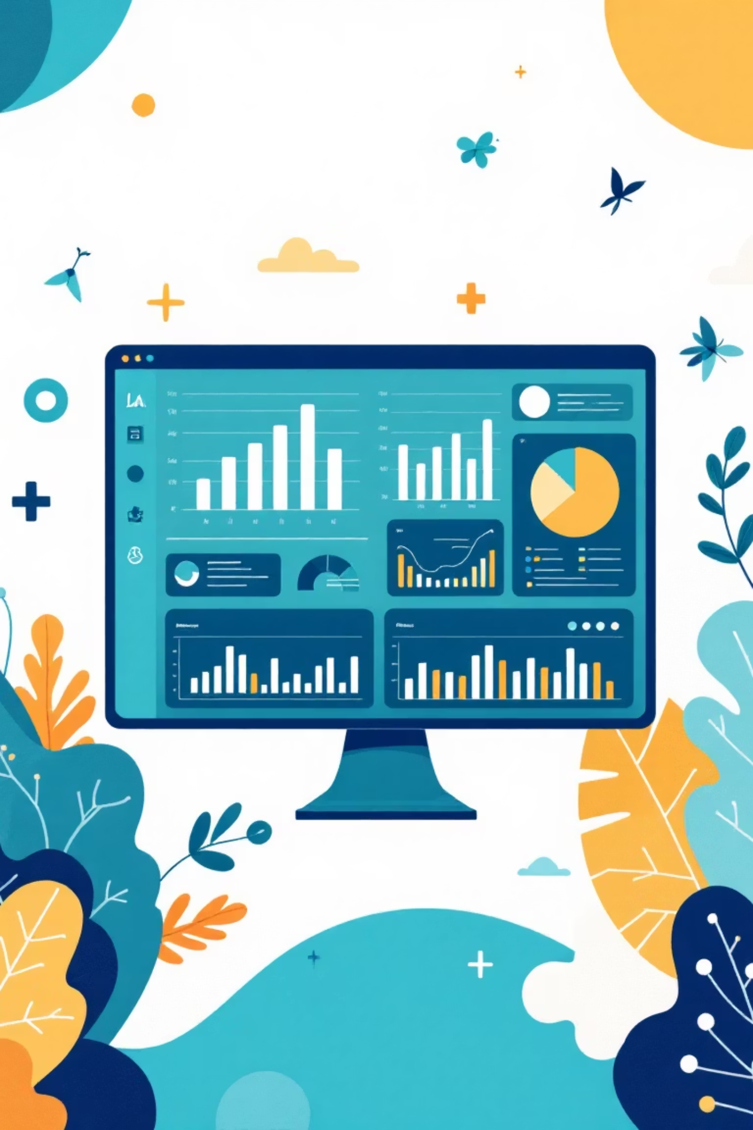
Dashboard Highlights
1
Executive Overview
Centralized KPI dashboard featuring interactive filters for real-time business performance monitoring. Stakeholders can quickly assess overall health and drill down into specific areas of interest.
2
Sales Trend Analysis
Dynamic line chart visualization tracking revenue patterns over time with seasonal trend identification and forecasting capabilities for strategic planning purposes.
3
Product Intelligence
Comprehensive product performance analysis showcasing top performers and profit margin insights to optimize inventory decisions and marketing investments.
4
Geographic Performance
Interactive map visualizations highlighting regional sales performance with heat mapping to identify high-opportunity markets and underperforming territories.

Slide 8





Insights & Findings
Seasonal Patterns
Q4 consistently delivers peak sales performance, primarily driven by strategic holiday marketing campaigns and increased consumer spending patterns during year-end shopping seasons.
Category Performance
Category A demonstrates remarkable consistency with sustained double-digit growth rates, indicating strong market position and effective product-market fit for continued investment.
Regional Challenges
Region X shows concerning underperformance despite maintaining a substantial customer base, suggesting potential supply chain disruptions or distribution inefficiencies requiring immediate attention.
Customer Loyalty
Repeat customers contribute approximately 40% of total revenue, highlighting the critical importance of retention strategies and customer satisfaction programs for sustainable growth.

Slide 9



Recommendations
Optimize Q4 Preparation
Strategically increase inventory levels and marketing budget allocation for top-performing categories before Q4 peak season to maximize revenue opportunities and prevent stockouts.
Address Regional Issues
Conduct comprehensive investigation of logistics and distribution processes in Region X to identify root causes of delays and implement corrective measures for improved performance.
Enhance Customer Retention
Launch targeted loyalty programs and personalized marketing campaigns to improve customer retention rates and increase lifetime value of existing customer relationships.

Slide 10

Next Steps
1
Automation Implementation
Configure automated refresh schedules and establish email subscription services for key stakeholders to ensure continuous access to updated insights and maintain decision-making momentum.
2
Data Integration Expansion
Integrate additional data sources including CRM systems and social media analytics platforms to create a comprehensive 360-degree view of business performance and customer behavior.
3
Continuous Optimization
Establish regular monitoring protocols and iterative KPI refinement processes to ensure the dashboard evolves with changing business needs and maintains strategic relevance.

